Slide 1
Group 7
Online Review
Cliffen, Wen Rui, Yi Fan, Xian Shuang

Slide 2
Feedback from PM review:
Each iteration = Mini waterfall
Show history of regression testing
No buffer day in critical paths
Good testcases find 1 error at a time
Bigger fonts

Slide 3
Changes made after PM review:
Critical paths for iter3 & iter4
Bird’s eye view of the project
Bigger fonts
IP address!

Slide 4
Functionalities
Do you plan to drop/add any functionalities?
No plans to drop functionalities
Additional functionalities
Display student’s current timetable
Search for classes via class names
Do you plan to use any PHP frameworks?
No

Slide 5
Functionalities completed:
Login page [iter1]
Bootstrap [iter1]
User bidding functions [iter2]
Admin start/stop round functions [iter2]
Round 1 clearing logic [iter2]

Slide 6
AWS deployment
Ip address: 13.250.100.131
Password for admin:123

Slide 7
Schedule
Week 5-7 [iteration 1 ] completed
Week 7-9 [iteration 2]
Week 9-11 [iteration 3]
Week 11-13 [iteration 4]
Week 14 [iteration 5]

Slide 8
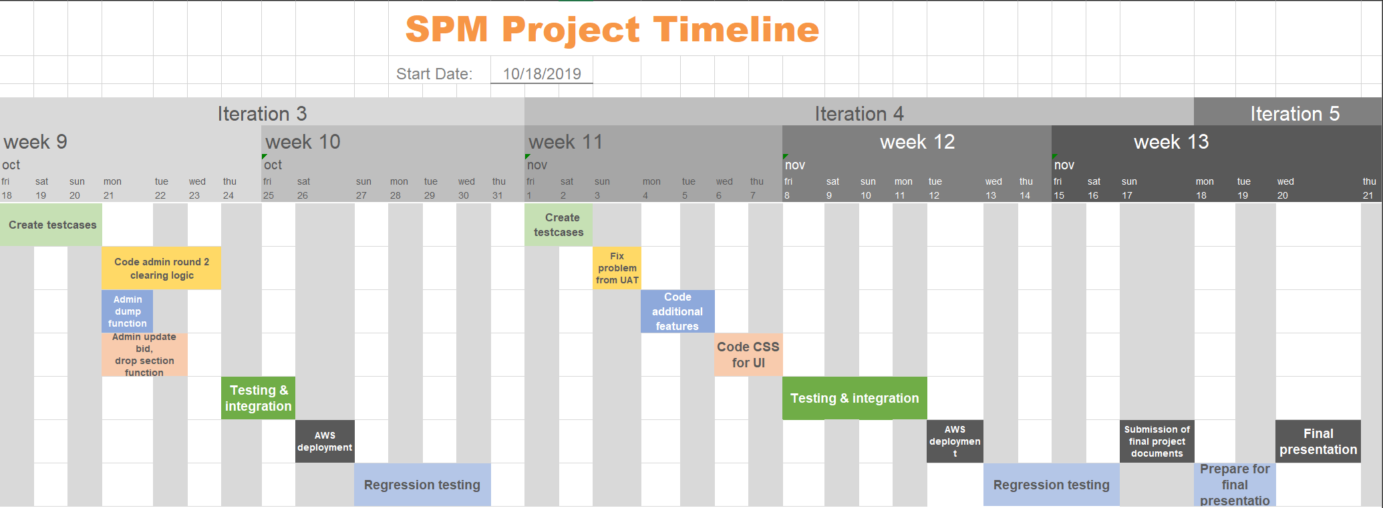


Slide 9
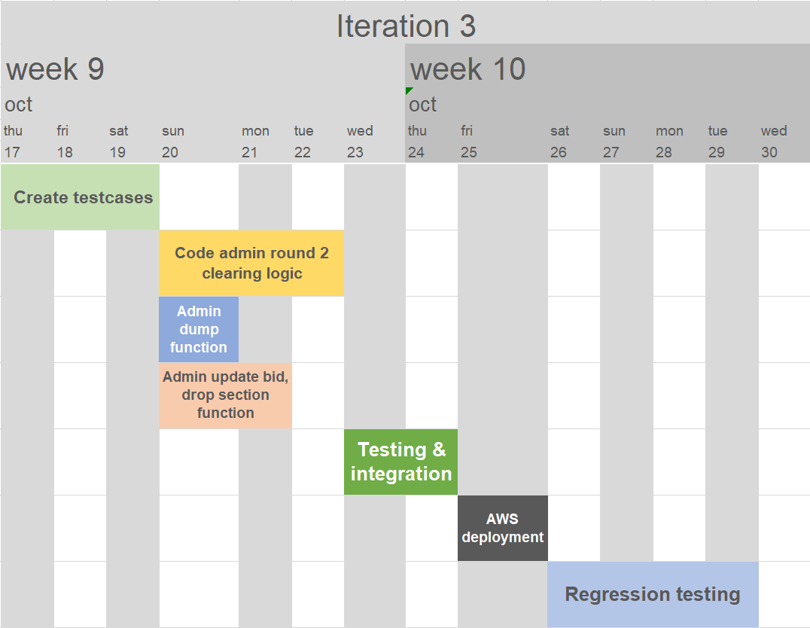

Slide 11
al path
al path
Design
Coding
Integration
Deployment
Regression testing
20/10
4
6
3
Code Admin Round 2 Clearing Logic
0
17/10
1
1
1
Check requirement & delegate tasks
0
4
6
18/10
20/10
23/10
25/10
26/10
1
1
4
4
7
8
9
9
10
13
2
3
1
Code admin dump functions
2
2
Testing & Integration
0
1
Deploy database to AWS
0
4
Regression testing & Debugging on AWS
0
2
Create JSON & Manual test cases
0
17/10
2
3
6
6
7
8
9
9
10
13
1
1
1
Create test plan
0
20/10
4
5
2
Code admin update bid/ delete bid/ drop section functions
1
1
1
Iteration 3
5
6
Notes:
Scheduling planning [1]
Preparation of slides []
Create test cases []
Create bug metrics [2]
Admin Login page [2]
Bootstrap (1. Without validation 2. With validation) [2] [3]
Code json checker [3]
Test bootstrap using json checker & bug log [4]
Manual testing []
User login page [3]
Create simple test cases [2]

Slide 12
al path
al path
Design
Coding
Integration
Deployment
Regression testing
31/10
1
1
1
Check requirement & delegate tasks
0
01/11
02/11
04/11
06/11
08/11
12/11
13/11
17/11
4
4
5
7
8
9
9
10
13
4
4
1
1
4
4
6
2
Code CSS for UI
0
1
Deploy database to AWS
0
4
Regression testing & Debugging on AWS
0
1
Submission of final project documents
0
2
3
2
Code fix problems from UAT
0
2
Code additional features
0
4
Testing & Integration
0
1
Create JSON & Manual test cases
0
31/10
2
3
6
6
4
6
5
6
7
8
9
9
10
13
4
4
1
1
1
Create test plan
0
1
1
Iteration 4
Notes:
Scheduling planning [1]
Preparation of slides []
Create test cases []
Create bug metrics [2]
Admin Login page [2]
Bootstrap (1. Without validation 2. With validation) [2] [3]
Code json checker [3]
Test bootstrap using json checker & bug log [4]
Manual testing []
User login page [3]
Create simple test cases [2]

Slide 13
18/11
20/11
5
7
5
7
2
Prepare for final presentation
0
1
final presentation
0
5
7
5
7
Iteration 5
Notes:
Scheduling planning [1]
Preparation of slides []
Create test cases []
Create bug metrics [2]
Admin Login page [2]
Bootstrap (1. Without validation 2. With validation) [2] [3]
Code json checker [3]
Test bootstrap using json checker & bug log [4]
Manual testing []
User login page [3]
Create simple test cases [2]

Slide 14
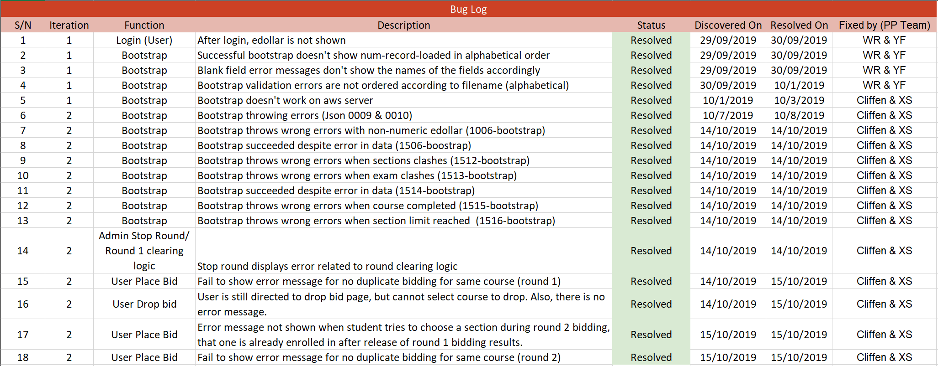
Bug log

Slide 15
Bug log for iteration 2:

Slide 16
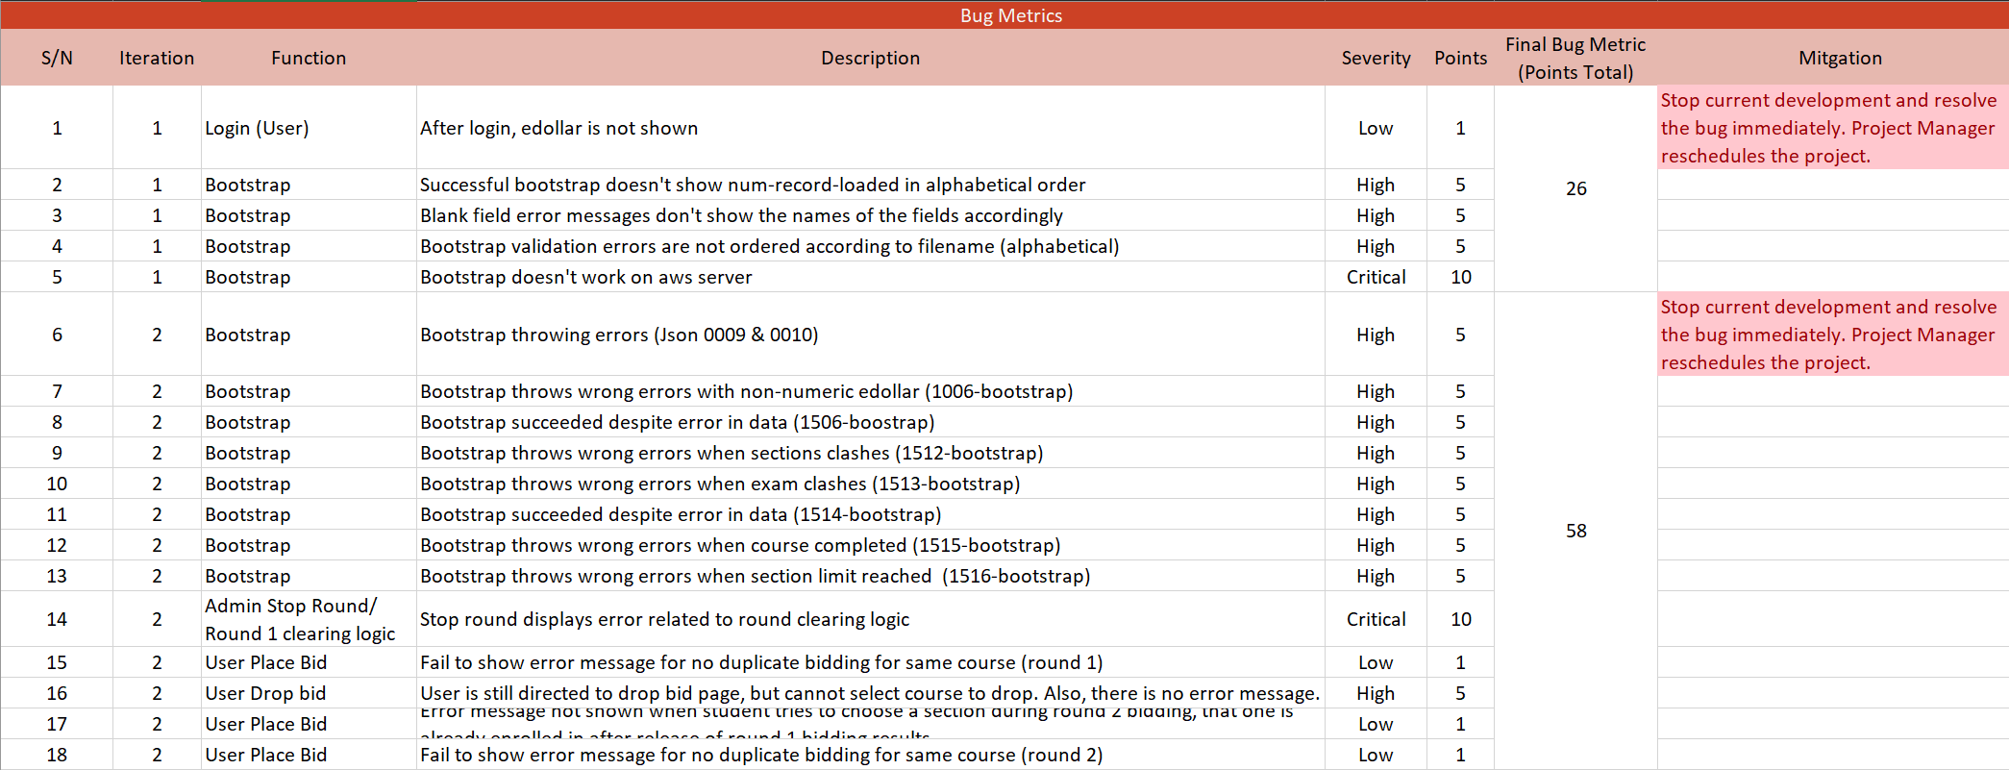
Bug Metrics

Slide 17
Bug Metrics for iteration 2:

Slide 18
Roles & Responsibilities for iter2:
Roles | Week 8 | Week 9 Demo
PM/ Pair programmer 1A | Yi Fan
Pair programmer 1B/ Minutes taker | Wen Rui
Pair programmer 2A | Cliffen
Pair programmer 2B | Xian Shuang

Slide 19
Roles & Responsibilities for Upcoming iter:
Roles | Week 10 | Week 11 UAT | Week 12 | Week 13 Submit report documents | Week 14 Final
PM/ Pair programmer 1A | Xian Shuang |  | Wen Rui |  | Cliffen
Pair programmer 1B/ Minutes taker | Cliffen |  | Yi Fan |  | Xian Shuang
Pair programmer 2A | Yifan |  | Xian Shuang |  | Wen Rui
Pair programmer 2B | Wen Rui |  | Cliffen |  | Yifan

Slide 20
Thank you

